Slide 1

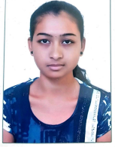
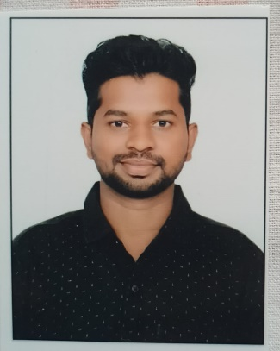



DEEPA L
Education and certificates
Bachelor of Engineering in
Electronics and communication
Analyst/Software Engineer
Base Location: MUMBAI
Email ID:
DEEPA.A.L@CAPGEMINI.COM
Skills
Mobile No: +918296719035
Grade: A4
EMP ID-46205972
Java | Basics, OOPS, Exception Handling, Collections & Generics, Java 8 Features
Spring Framework | Spring MVC. Spring JDBC, Spring Boot
React | Components, Hooks, Virtual DOM, Routing, Forms & Validation
RDBMS | MySQL,Oracle
UI Technology | HTML 5, CSS, JavaScript
Tools | Git ,GitHub, Postman, Eclipse, Visual Studio code
Add On Skills | Communication , Team management
Strengths
Full Stack Developer
Good Knowledge of java programming.
Achievement
Airline ticket booking
Case study of Airline ticket booking along with Spring Boot.
Case study of Expense tracker along with HTML5, CSS and React used as User Interface.
•Good with Spring Framework
•Good in developing web pages using HTML, CSS.
•Currently learning on iTransform: Full Stack Angular, Spring Boot MS & MongoDB
Full Stack developer with React and Full Stack Java Developer
Hands on experience in developing web pages
using HTML5, CSS3, REACT.
Proficient in creating Single page Web Application in
REACT with routing.
Check out my work on GitHub
Presentation Title | Author | Date © Capgemini 2017. All rights reserved | 1

